Slide 1
EU Cohesion Policy Conference
Bratislava, 15 - 16 September 2016

Slide 2
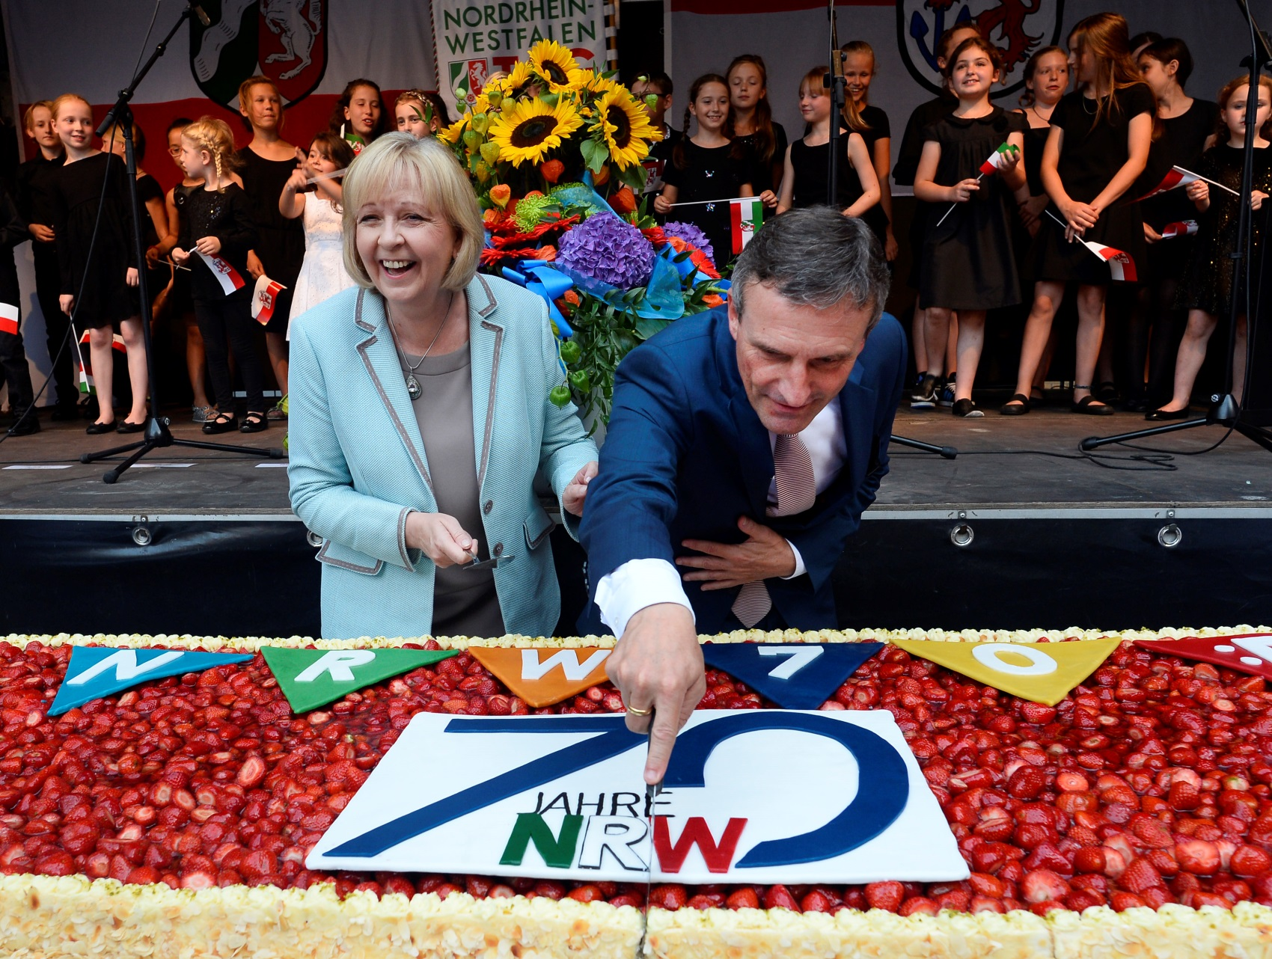

Slide 3
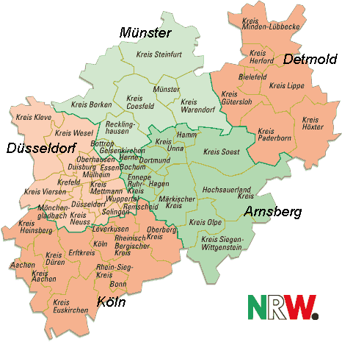
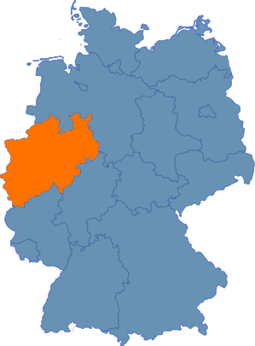
North Rhine-Westphalia

Slide 4
Facts & Figures: NRW
34.000 square kilometres
17 Million inhabitants: the federal state with the highest population
GDP of 624,7 Billion Euros
Generates 21,9% of the German GDP
… and least but not last: invests 2,4 Billion Euros from the European Structural- and Investment Funds.

Slide 5
Structural change and todays challenges

