Slide 1
Performance and Result Orientation of the ESIF
Mariana HRISTCHEVA,
DG REGIO, Evaluation and European Semester Unit
EU Cohesion Policy Conference
Bratislava, 15-16 September 2016
Cohesion Policy

Slide 2
2007-2013 was a very demanding period:
the deepest economic/financial crisis in the EU history
12 new MS with different development needs
Cohesion Policy had
measurable impact
in all regions and Member States and produced tangible results
Notes:
SLIDE 2
2007-2013 Cohesion policy programmes were implemented in highly demanding times:
We navigated the deepest economic/financial crisis in the EU history and
We had 12 new Member States with different development needs
Despite these premises our ex post evaluation has highlighted that Cohesion Policy had measurable impact in all regions and Member States (including net contributors) and produced tangible results

Slide 3
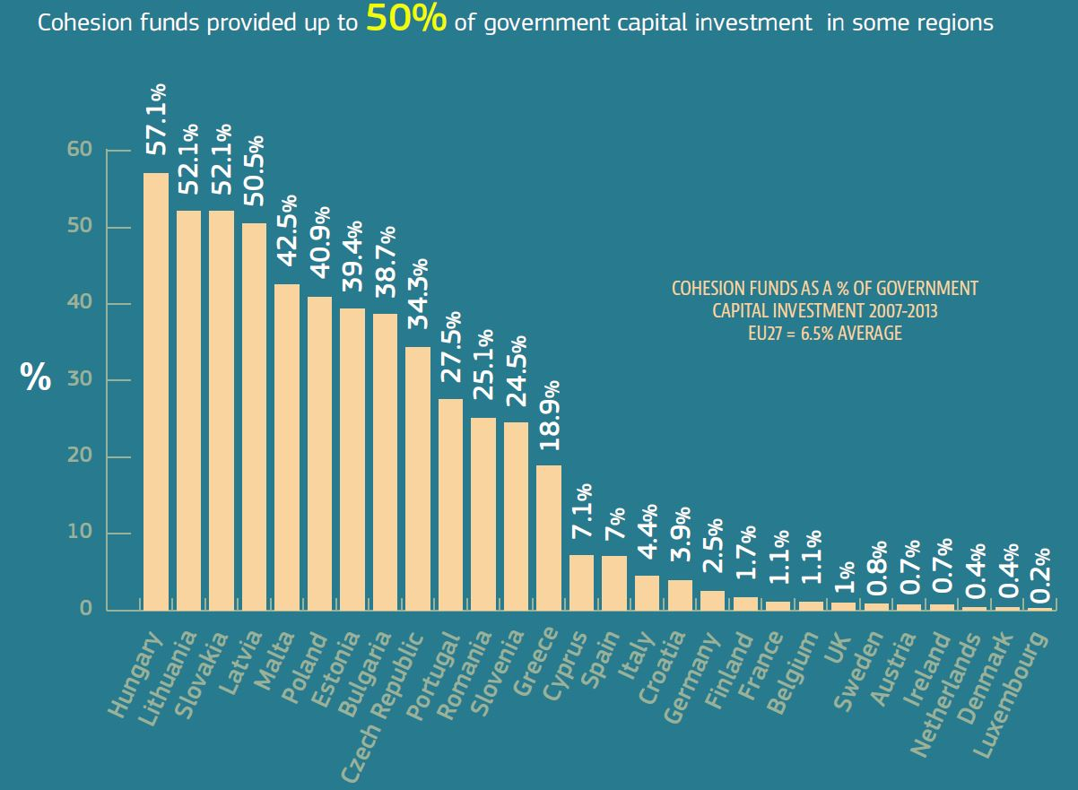
funding public investment
COHESION POLICY AS A % OF GOVERNMENT CAPITAL INVESTMENT 2007-2013
EU27 = 6.5% AVERAGE

Slide 4
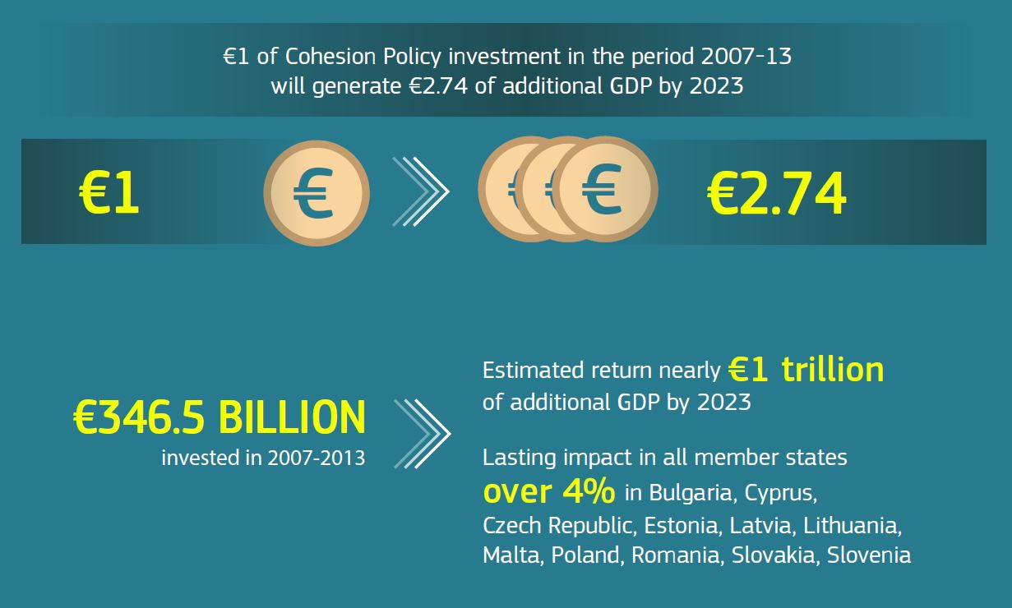
macroeconomic result Estimated additional income generated by Cohesion Policy* 2007-2013 by 2023
Hungary,
* Cohesion Policy = ERDF, CF, ESF

Slide 5
Key findings on performance emerging from the ex post evaluation:
Existing limits in the design of 2007-13 programmes:
Very general definition of objectives: difficult to define projects and relate results
Dispersion of funding over many policy areas or objectives: difficult to achieve meaningful results
Non-compulsory core indicators: difficult to monitor and progress and aggregate
Focus on absorption
Limited impact evaluation by Member States / programmes

Slide 6
Novelties for 2014-2020:
Reinforced focus on performance and results :
Thematic concentration and requirement for clearer programme objectives/improved intervention logic
stronger link with the EU economic governance, incl. ex ante conditionalities
strengthened monitoring provisions (both finance and outputs)
introduction of a performance framework and related performance reserve of 6% to incentivize implementation
stronger focus on evaluation of programme results (Evaluation Plans and impact evaluations).

Slide 7
2014-2020: Result Orientation
Three key questions to set clearer objectives:
What change should be achieved through the investment? Identify the "need" => identify a specific objective
How will that change be measured? =>Choose a result indicator, identify baseline, set a target
What actions can contribute to the wanted change? => Choose actions, set budget and output indicators

Slide 8
Performance Frameworks
Introduced in order to track progress with objectives
Defined at axis level; linked to the release of performance reserve (6%)
Performance review in 2019
Strengths:
Reflections on objectives and indicators
Strengthened coordination
Comparability across EU
Example:
Table 6 in Operational Programmes
Priority Axis 1
Type of indicator | Measurement unit | Fund | Category of Region | Milestone 2018 | Final target 2023 | Data source
Output 1 | km | ERDF | In transition | x | xxx | MA
Output 2 | number | ERDF | In transition | y | yyy | MA
Financial resources | euro | ERDF | In transition | z | zzz | MA
Challenges:
Political ownership
Conservative target setting
Balance: short–term outputs and long-term results

Slide 9
Evidence on policy implementation: monitoring
Open Data Platform:
EC annual summary reports (the first one to be adopted by end-2016) and strategic reports (in 2017 and 2019) on ESI Funds
i

Slide 10
Evidence on policy impacts: evaluation
More than 1500 impact evaluations for 2014-2020 in total
Impact evaluations expected from MS by year
2018: 235 evaluations
+ EC evaluation activities (interim evaluations, meta-analyses, studies, ex-post evaluation)

Slide 11
Thank you!
ESIF Open Data Platform: https://cohesiondata.ec.europa.eu/
Evaluation: http://ec.europa.eu/regional_policy/en/policy/evaluations/
Strategic reporting 2007-2013: http://ec.europa.eu/regional_policy/index.cfm/en/policy/how/stages-step-by-step/strategic-report/

