Slide 1
Productivity, Regional policy and economic governance EU Cohesion Policy Conference bratislava, 15-16 sept 2016
Joaquim Oliveira Martins
Regional Development Policy Division, OECD

Slide 2
The OECD productivity problem is to some extent a regional issue
Notes:
Introduction
3 main points could be discussed: (1) Rationale for the Principles; (2) The Principles: consultation procedure and TDPC Ministerial meeting; (3) Next steps: implementing and monitoring the Recommendation

Slide 3
Productivity growth of frontier regions outpaces that of most regions
Averages of top 10% (frontier), bottom 75%, and bottom 10% (lagging) regional GDP per worker, TL2 regions
Notes: Average of top 10% and bottom 10% TL2 regions, selected for each year. Top and bottom regions are the aggregation of regions with the highest and lowest GDP per worker and representing 10% of national employment. 19 countries with data included.

Slide 4
Where are the frontier and the catching-up regions? TL2s, 2000-2013

Slide 5
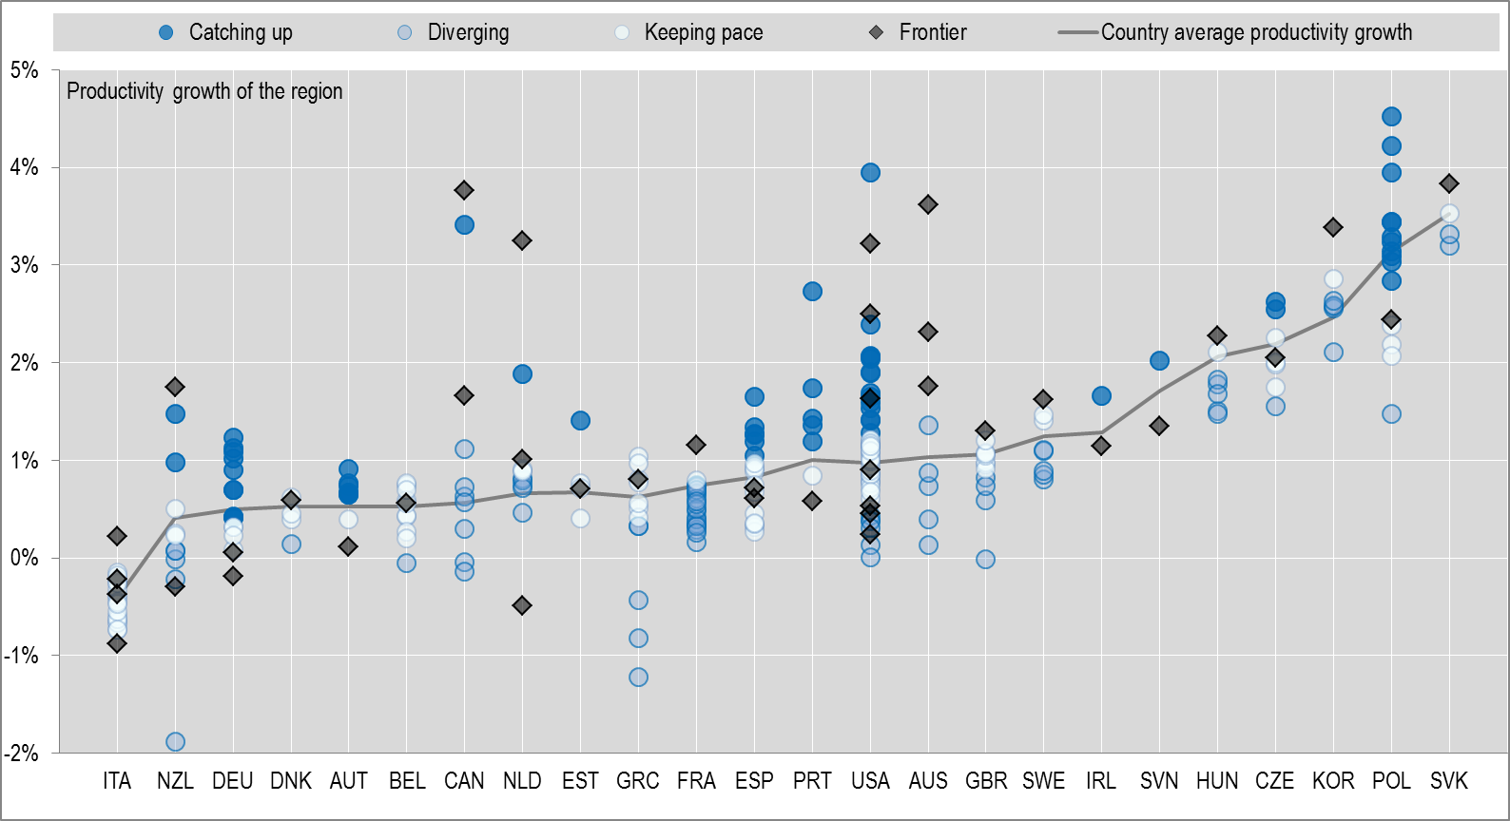
How regional catching-up compounds into national labour productivity growth?
➔ Regional catching-up can play an important role for national productivity growth
Annual average growth in real per worker GDP between 2000-2013 (or closest year available).

Slide 6
Region’s contributions to national growth vs. labour productivity growth: Austria

Slide 7
Region’s contributions to national growth vs. labour productivity growth: UK

Slide 8
The tradable sector appears to make the difference: due to “unconditional” convergence?
All tradable sectors, TL2 regions
Notes: Tradable sectors are defined by a selection of the 10 industries defined in the SNA 2008. They include: agriculture (A), industry (BCDE), information and communication (J), financial and insurance activities (K), and other services (R to U). Non tradable sectors are composed of construction, distributive trade, repairs, transport, accommodation, food services activities (GHI), real estate activities (L), business services (MN), and public administration (OPQ).

Slide 9
A role for policies
Notes:
Introduction
3 main points could be discussed: (1) Rationale for the Principles; (2) The Principles: consultation procedure and TDPC Ministerial meeting; (3) Next steps: implementing and monitoring the Recommendation

Slide 10
Broad policy responses
Economy-wide structural reforms help regional catching-up, more so if complemented by place-based policies
Well-designed and well‑implemented public investments may support regional catching-up (cf. OECD Governance of Public Investment Toolkit)
Multi-level governance and territorial reforms can unlock productivity potential and support inclusion

Slide 11
Specific role for regional policies
Regional development policy most focused on growth and productivity
Address urban policy split between transport, spatial planning, housing and social inclusion
Reform of metropolitan areas can enhance the effect of labour market, product market and innovation policies
Rural policies often remain sectoral (e.g. agriculture), but efforts to broaden the scope: focus on the economics of low-density areas and rural-urban linkages (forthcoming OECD Regional Outlook 2016)

Slide 12
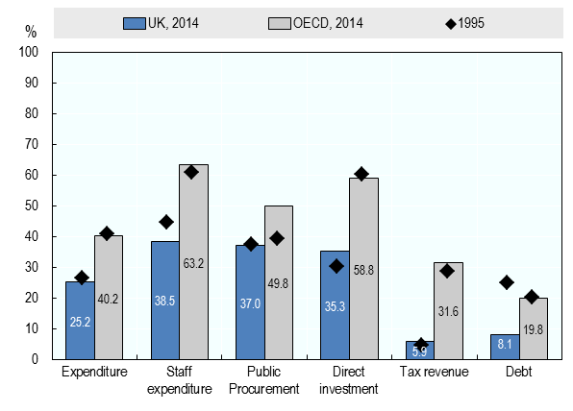
The role of subnational governments needs to be more widely recognised
12
Notes:
Finally last indicator: subnational debt …
It accouns for nearly 20% of government debt in the OECD (16% in the EU).

Slide 13
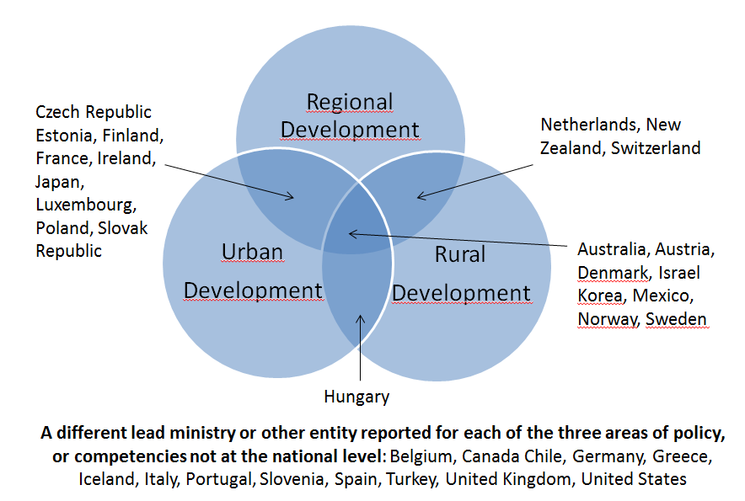
Governments need a better governance of regional, rural and urban policies
Reported lead ministries or entities across three policy fields
13

Slide 14
Bottom-line
Regional policies are important for national productivity growth
Their contribution is even greater when considering the contribution of environmental and social dimensions of well-being
Thus, they have to be properly integrated in the structural policy package for inclusive growth

Slide 15
Thank you!
Notes:
Introduction
3 main points could be discussed: (1) Rationale for the Principles; (2) The Principles: consultation procedure and TDPC Ministerial meeting; (3) Next steps: implementing and monitoring the Recommendation

