Slide 1
Slovak Presidency – EU Cohesion Policy Conference:
„Past Evidence, Current Experience and Future Perspectives“
___
Panel 3: ‘Further simplification of Cohesion policy & the future perspectives’
15 September 2016, Bratislava Johannes ROSSBACHER

Slide 2
Panellists:
Olga Letáčková, Deputy Minister, Ministry of Regional Development of the Czech Republic
Florence Clermont-Brouillet, Head of European Affairs at CGET (France)
Preben Gregersen, Regional Policy Director/ Head of Danish MA on EDRF/ESF (DBA)
Martin Weber, Director at the European Court of Auditors
Andriana Sukova-Tosheva, Director, DG EMPL
Nicholas Martyn, Deputy Director General, DG REGIO

Slide 3
Simplification – a never ending story…
13 Sept 2016:
Omnibus regulation
October 2002:
Ministerial Meeting
(Brussels)
July 2009: 2nd round of EC proposal for amendments (Gen Reg.)
18 Nov 2015:
Council Conclusions
July 2001:
Ministerial Meeting (Namur)
November2008: EC proposal for amendments within the “recovery package” (Gen Reg. & ESF / in particular SCOs)
10 July 2015:
“High Level Group on monitoring simplification for beneficiaries of ESI Funds” (4 meetings)
2000 - 2006
2007 - 2013
2014 - 2020

Slide 4
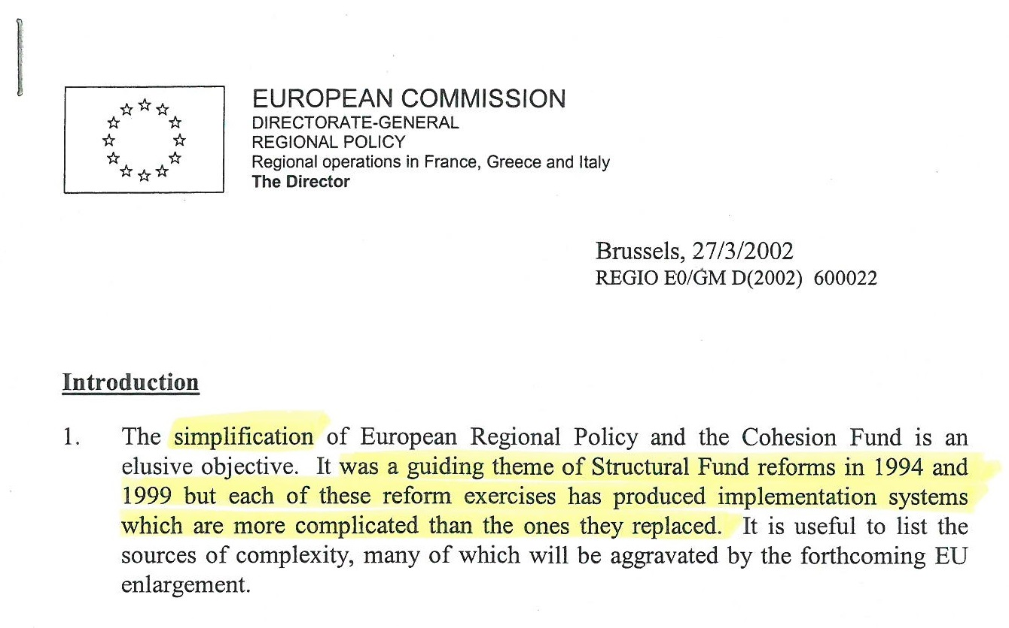

Slide 5
Simplification – a never ending story… …and dramatically increasing complexity.

Slide 6
Cohesion Policy – No. of documents & No. of pages
30 regul. + decisions
ca 95 Guidances
= ca 4.050 pages
16 regul. + decisions
ca 80 Guidances
17 regul. + decisions
= ca 1.750 pages
ca 100 Guidances
= ca 1.250 pages
2000 - 2006
2007 - 2013
2014 – 2016 (2020)

Slide 7
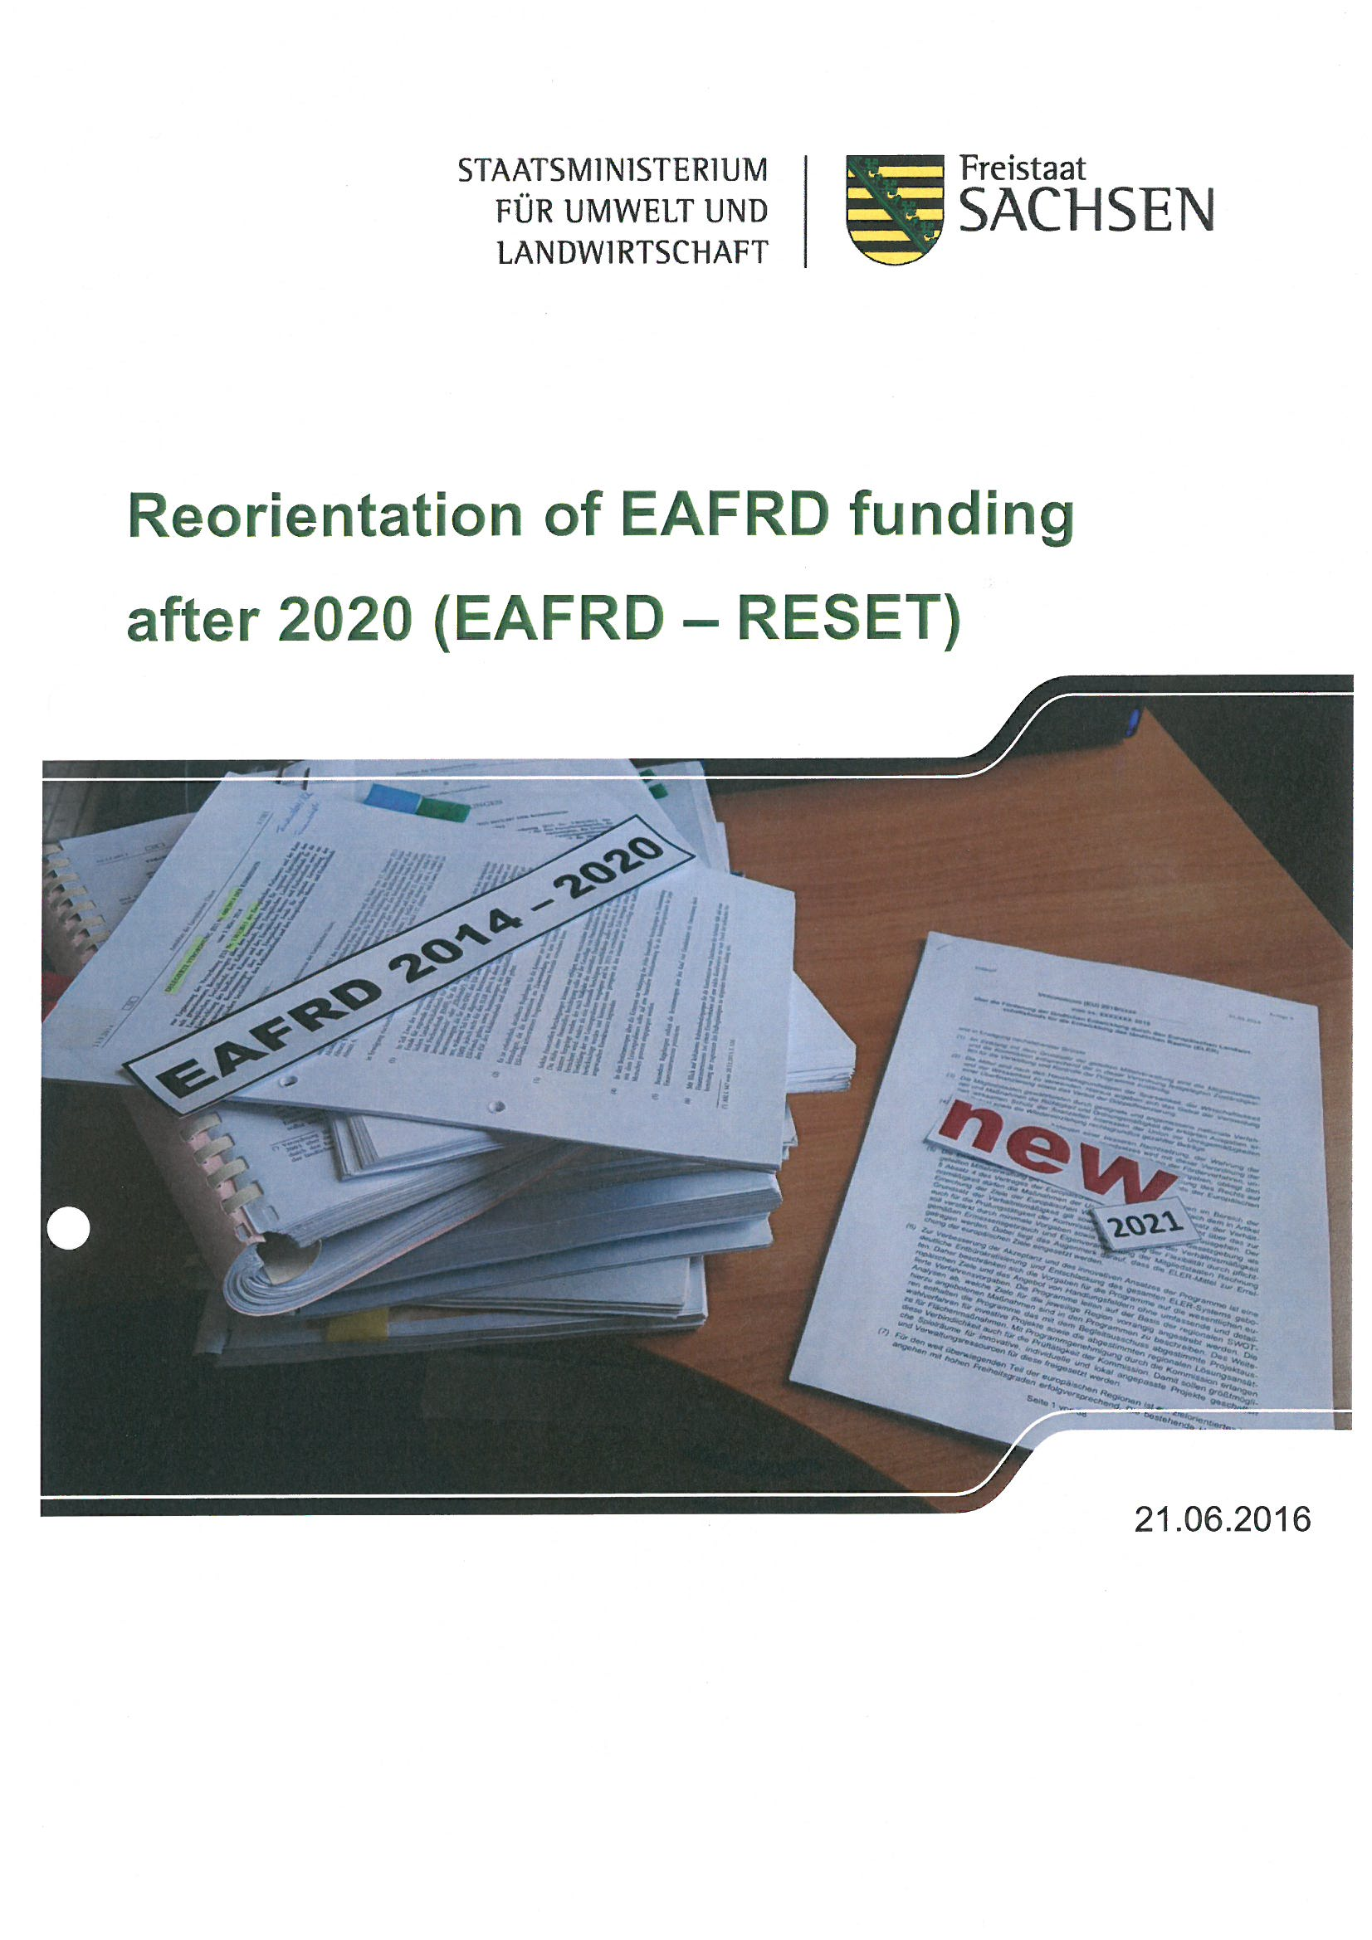
Saxon State Ministry of the Environment and Agriculture:
Reorientation of EAFRD funding after 2020 (“EAFRD – reset”): http://www.smul.sachsen.de/foerderung/download/ReorientationofEAFRDfundingafter2020_EAFRD-RESET.pdf

Slide 8
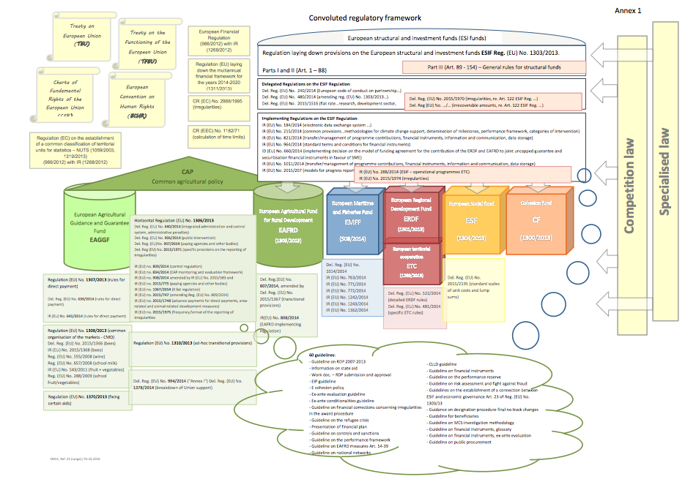
Source: Saxon State Ministry of the Environment and Agriculture (2016). Reorientation of EAFRD funding after 2020 (EAFRD – RESET): http://www.smul.sachsen.de/foerderung/download/ReorientationofEAFRDfundingafter2020_EAFRD-RESET.pdf

